Slide 1
AWS S3 Bucket Policy
Presented By KV Prem Kumar

Slide 2
Amazon S3 Bucket Policy:
An S3 Bucket Policy is a JSON document that you attach to an Amazon S3 bucket to define rules about who can access the bucket and what actions they can perform on the objects in the bucket. It helps manage permissions in a granular way, allowing for specific actions (like reading, writing, or deleting files) to be allowed or denied based on various conditions.

Slide 3
Key Concepts of S3 Bucket Policy:
Permissions: Bucket policies specify which users or services can access the bucket and what actions they are allowed to perform. These actions can include:
s3:GetObject: Allows reading objects from the bucket.
s3:PutObject: Allows uploading objects to the bucket.
s3:DeleteObject: Allows deleting objects from the bucket.
s3:ListBucket: Allows listing objects in the bucket.

Slide 4
Principals: A principal is the entity (user, group, role, or service) that is allowed or denied access. Principals can be specified in the policy as an AWS account ID, IAM user, or IAM role.
Actions: Actions specify the operations that are allowed or denied. For example, s3:GetObject is the action to allow retrieving objects, and s3:PutObject allows uploading objects.
Resources: This refers to the specific objects or buckets the policy is applied to. It can specify the entire bucket or individual objects within it. Example: arn:aws:s3:::my-bucket-name/*.
Conditions: Conditions are optional and specify when the policy is applied. For example, you might only allow access from a specific IP address or restrict access to a certain time period.

Slide 5
Steps to Set Up S3 Cross-Region Replication (CRR)
Login to the AWS Account.
In the console search for IAM in the search bar.

Slide 6
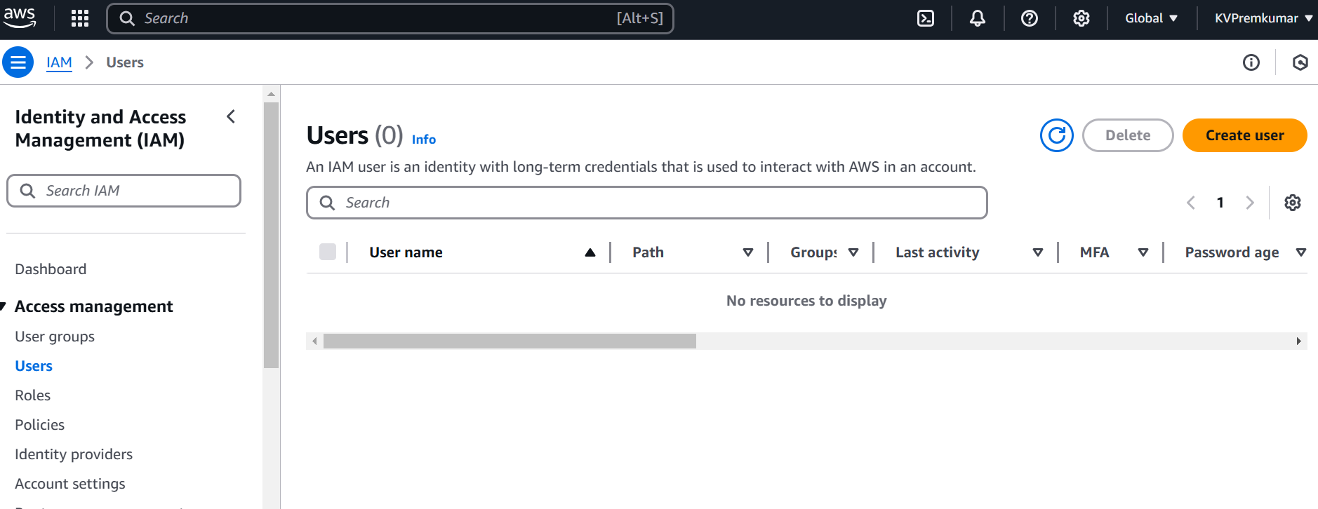
In users page Click on Create user.

Slide 7
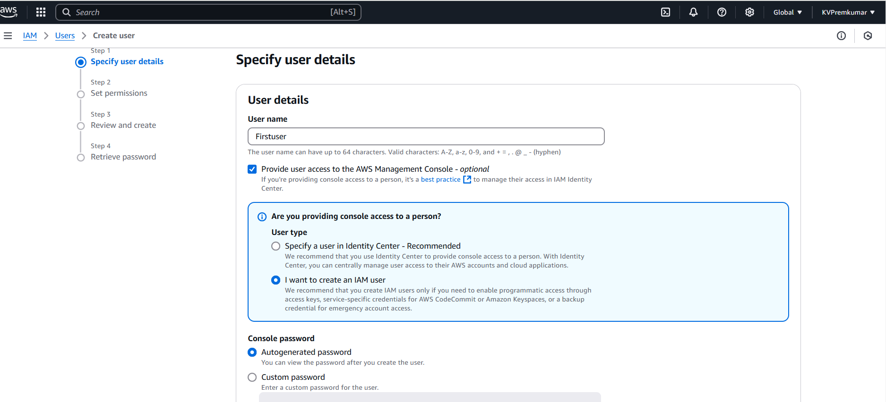
Give the user name (like Firstuser).
Select the option Provide user access to AWS management console.
Select the option I want to create an IAM user.

Slide 8
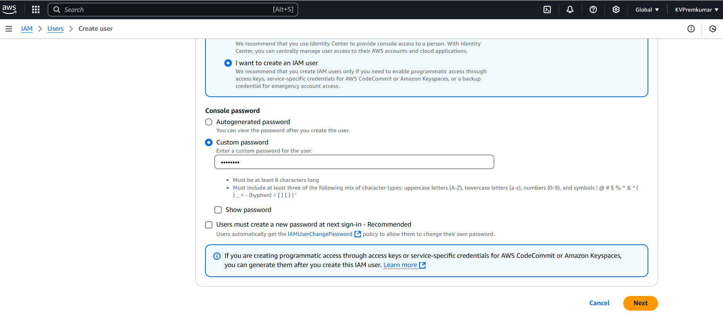
Give the custom password and click on Next.

Slide 9
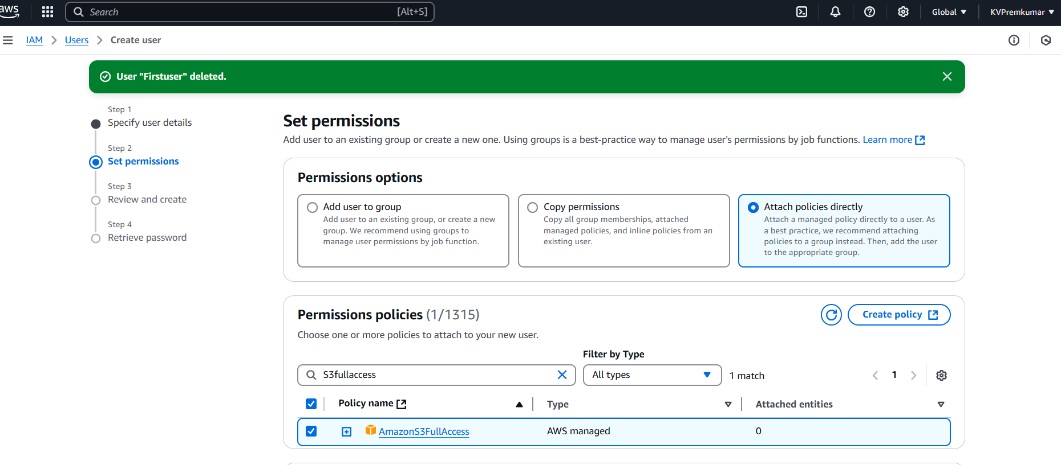
Select the option Attach policies directly in the permissions.
In the Permission Policies select S3FullAccess policy and click on Next.

Slide 10
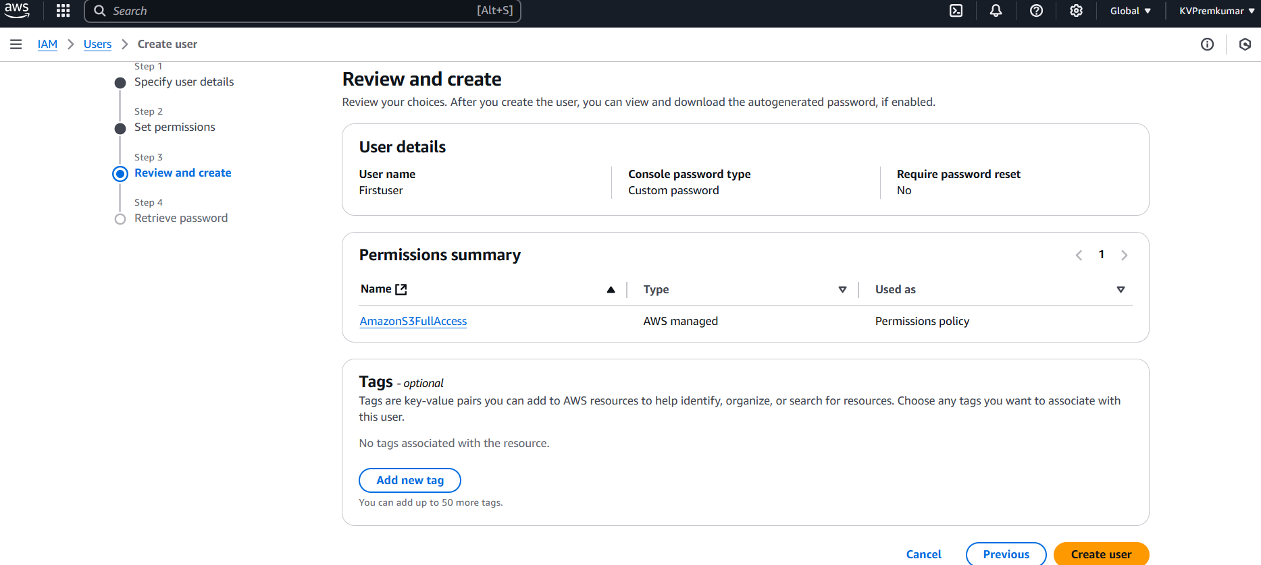
Check the review details and click on Create user.

Slide 11
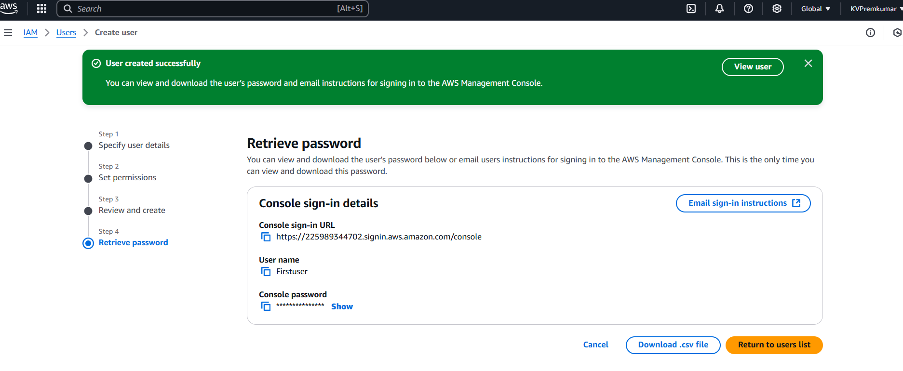
Copy the credentials and click on Return to users list.

Slide 12
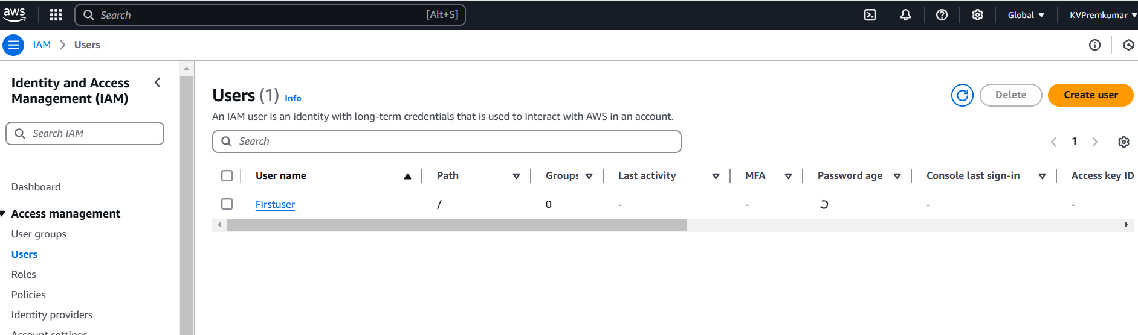
Here we can see the user is created.
Click on Firstuser to open.

Slide 13
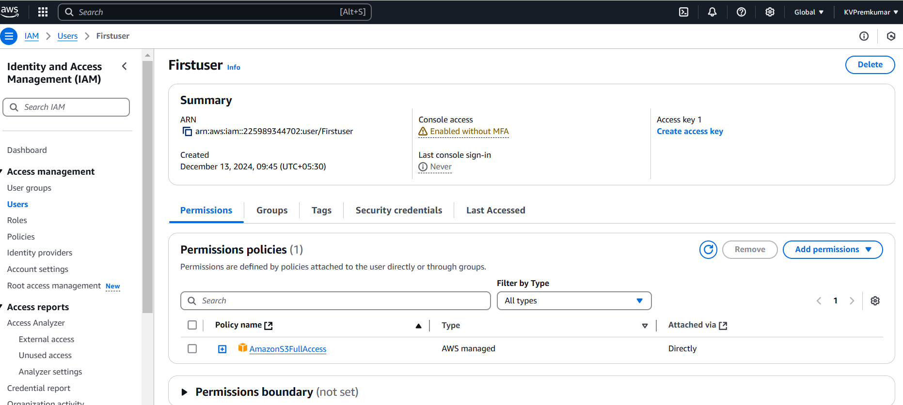
Copy the ARN link which is displayed in the Firstuser.

Slide 14
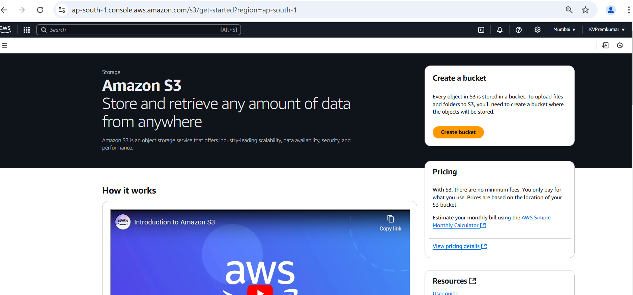
Go to S3 Console.
Click on Create Bucket.

Slide 15
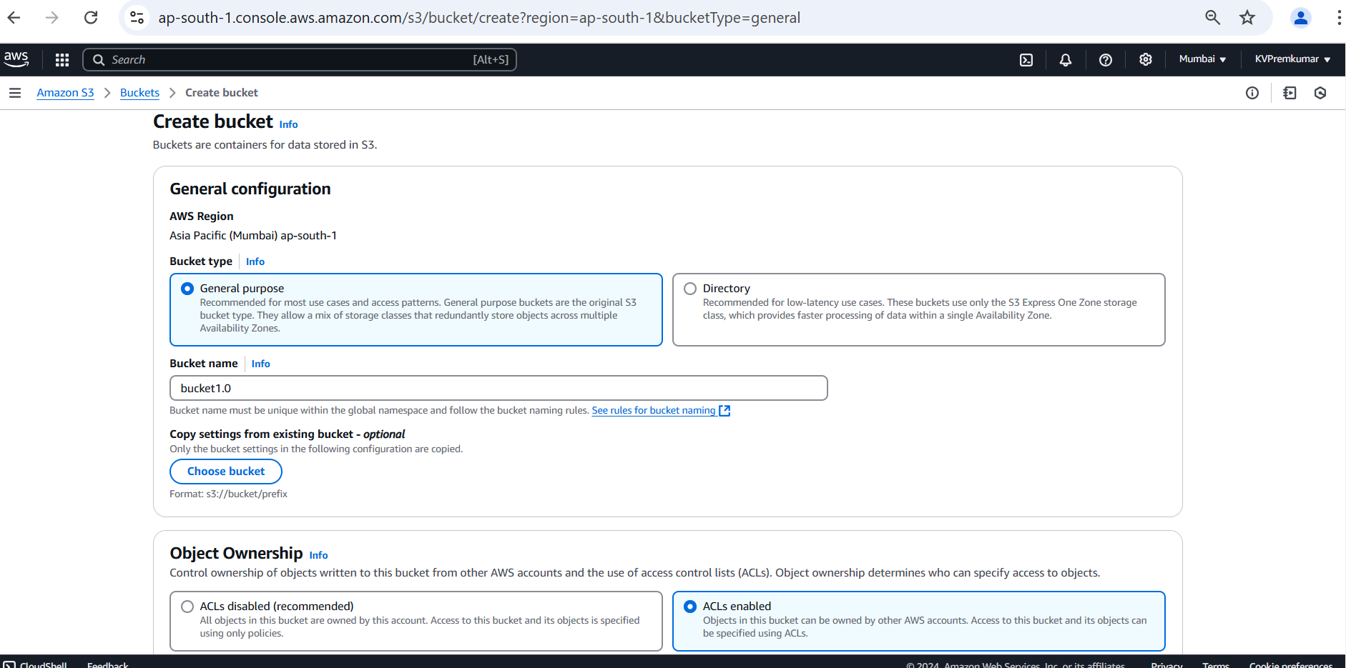
In General configuration select the bucket type as General Purpose.
Give the unique name to the bucket.
Enable the ACLs in Object Ownership.

Slide 16
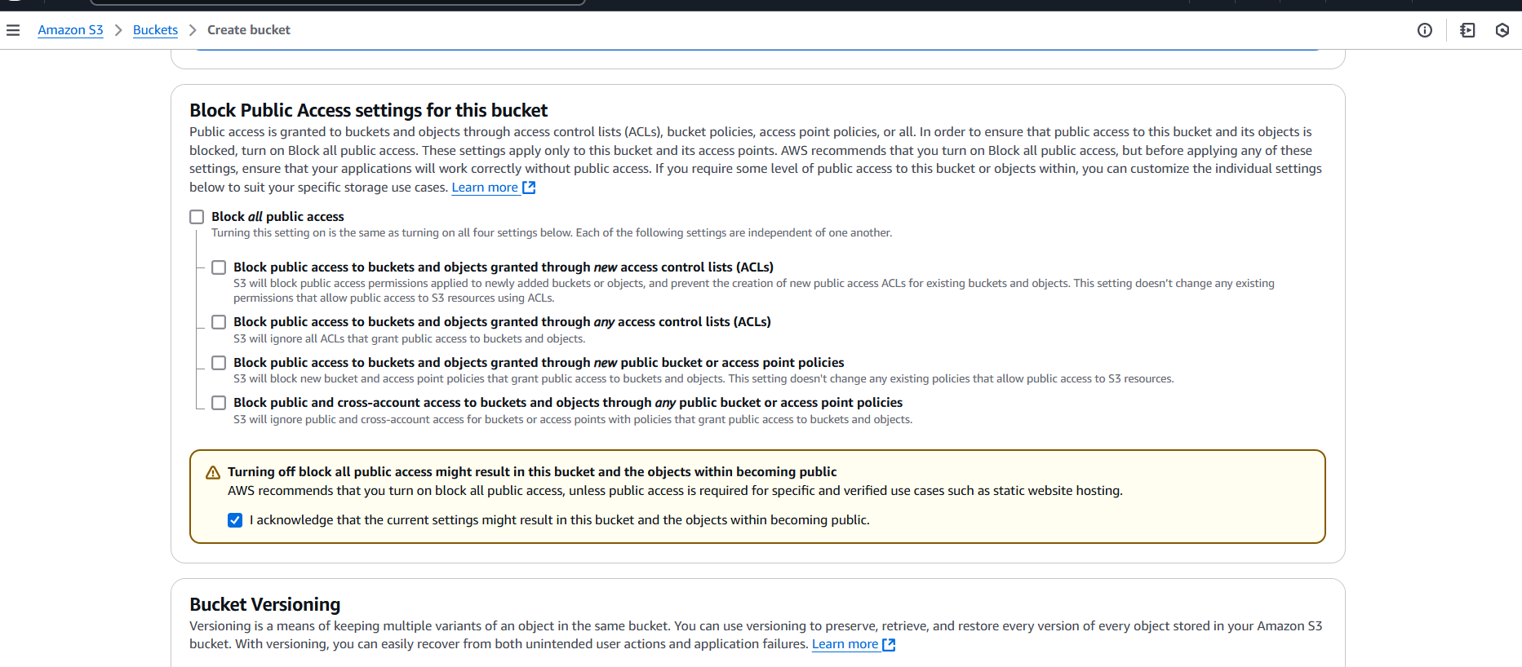
Deselect the Block all public access.
Select the Acknowledge option to off the block all public access.

Slide 17
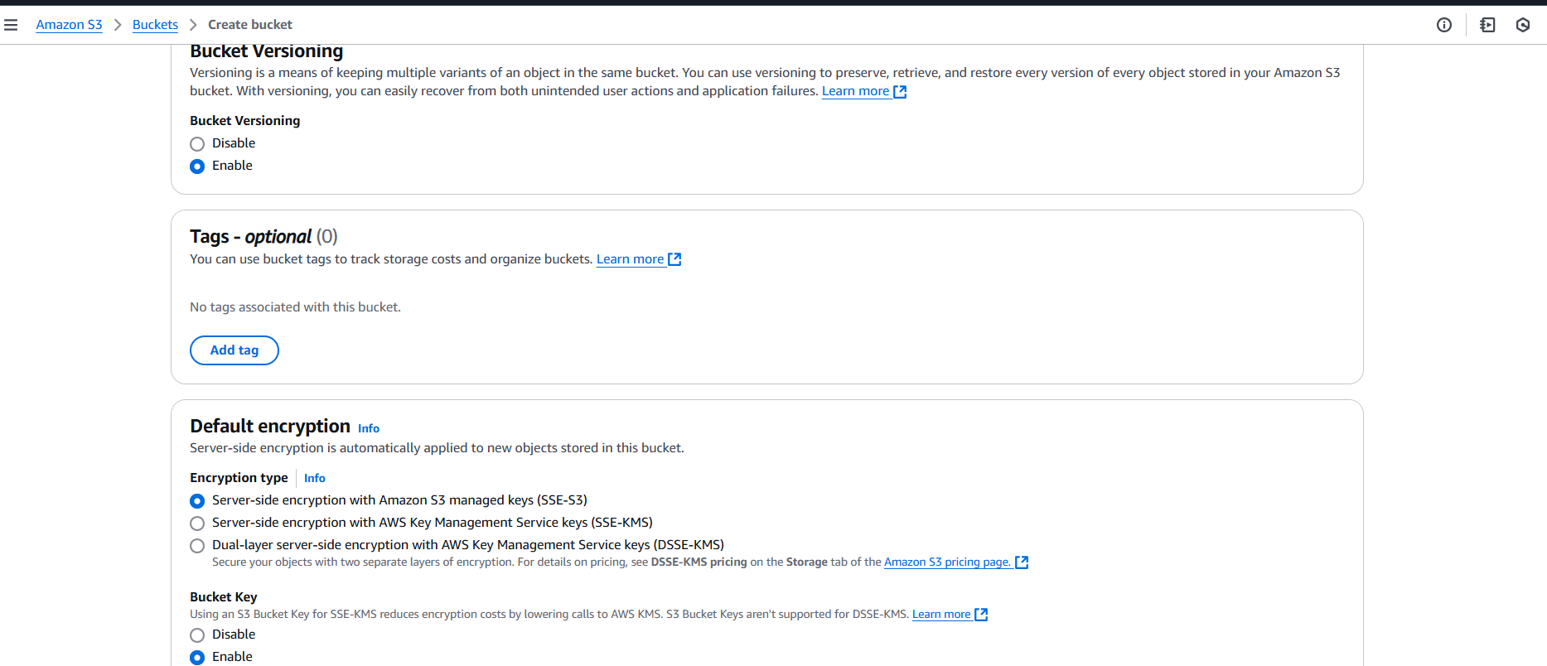
Enable the Bucket Versioning.
Keep the remaining all in default and Click on Create Bucket.

Slide 18
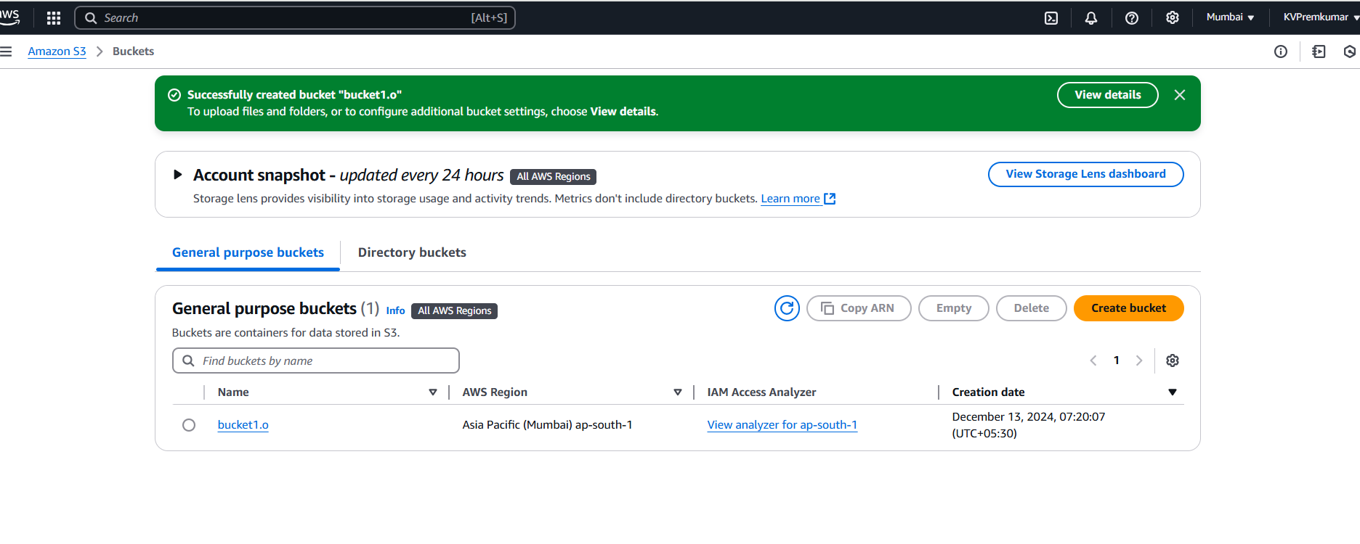
Here we can see the bucket creation.
Click on the bucket to open.

Slide 19
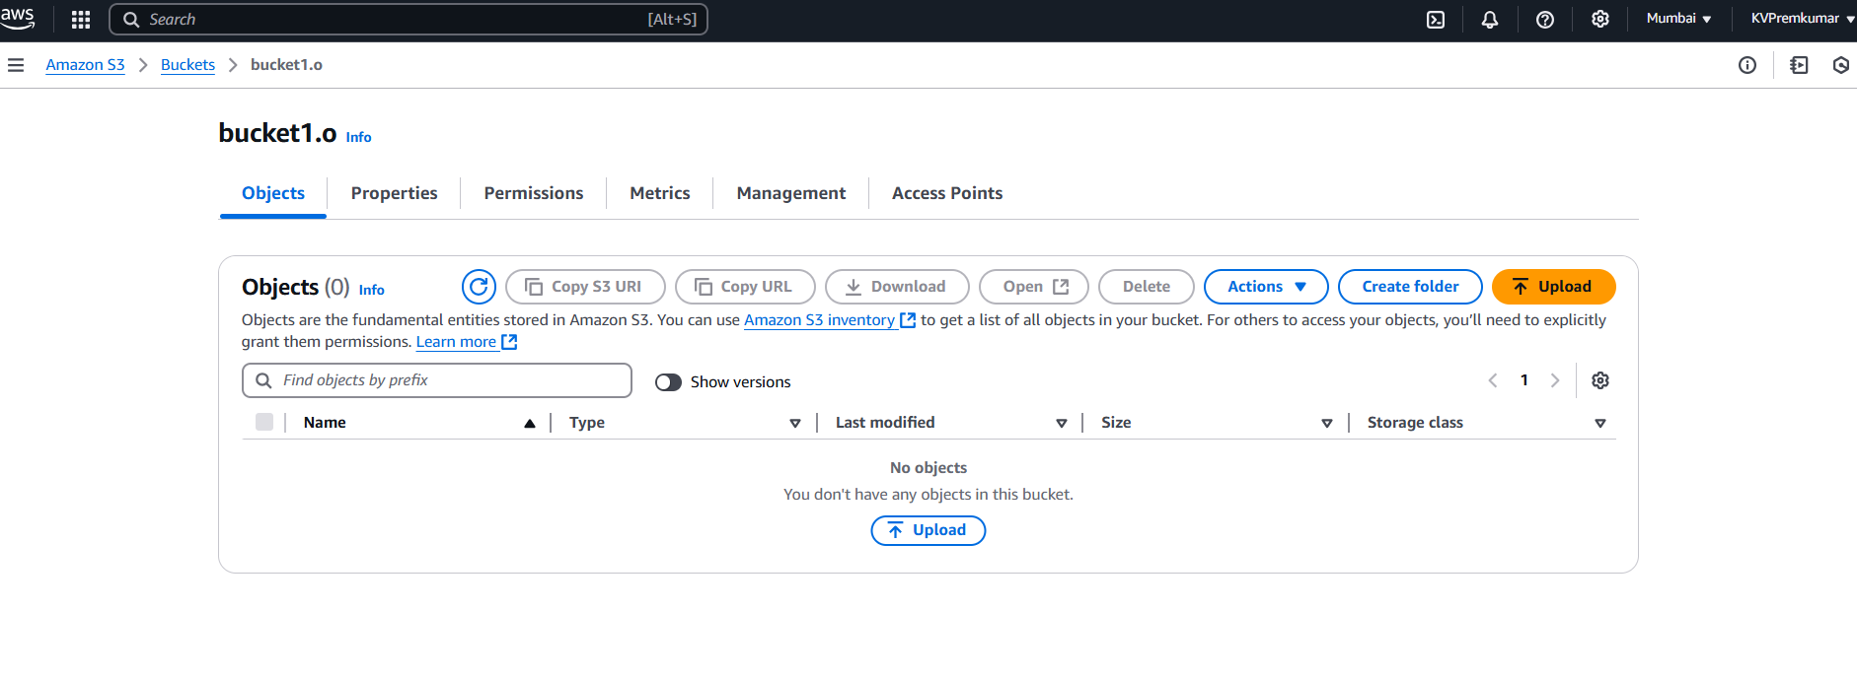
After opening the bucket, click on Upload.

Slide 20
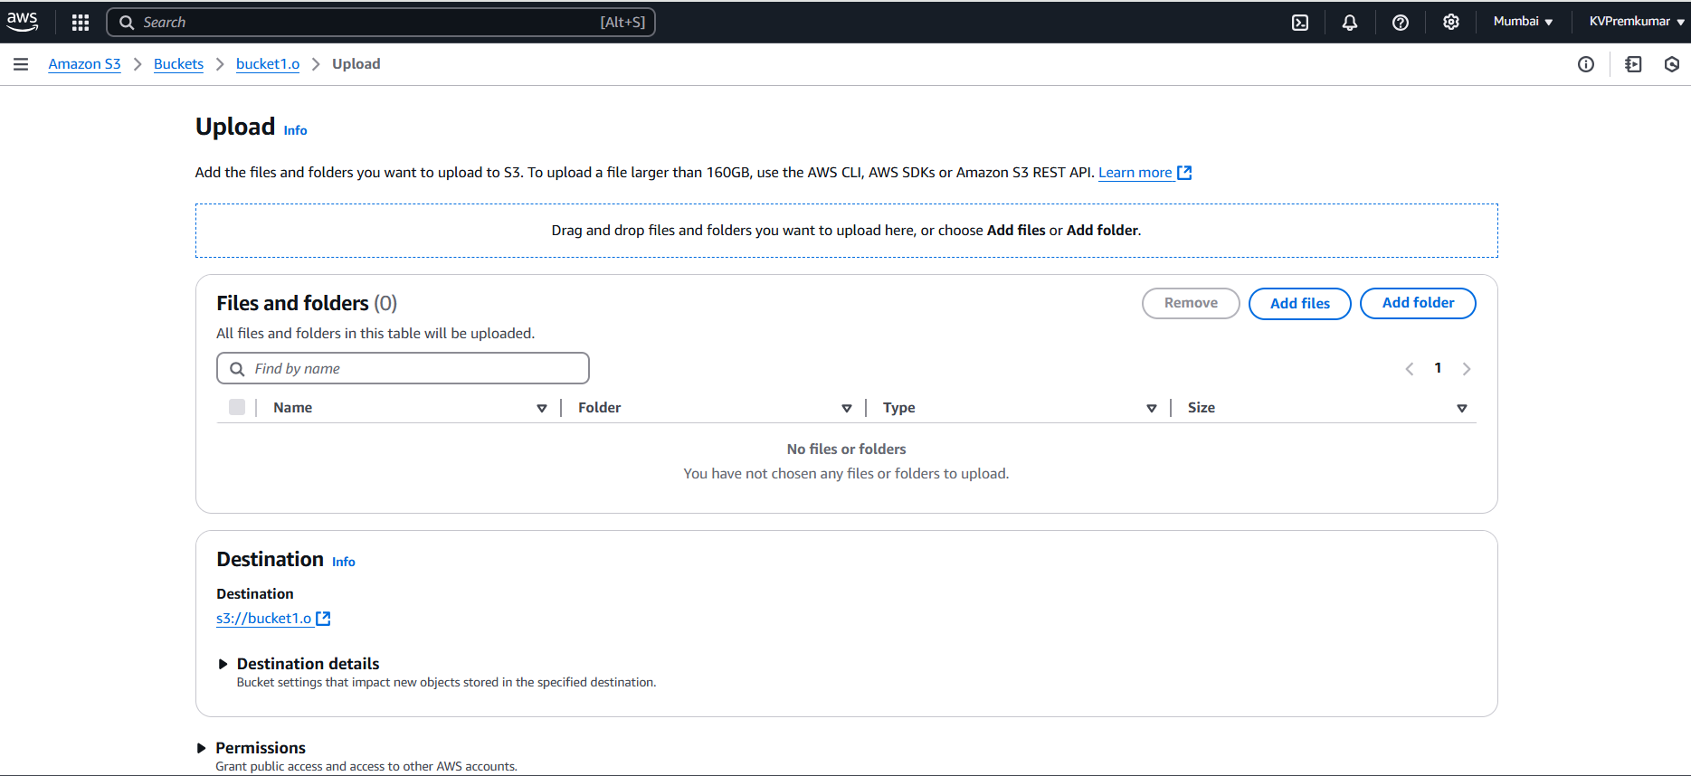
In Upload select Add File and select the file which you wants to upload.

Slide 21
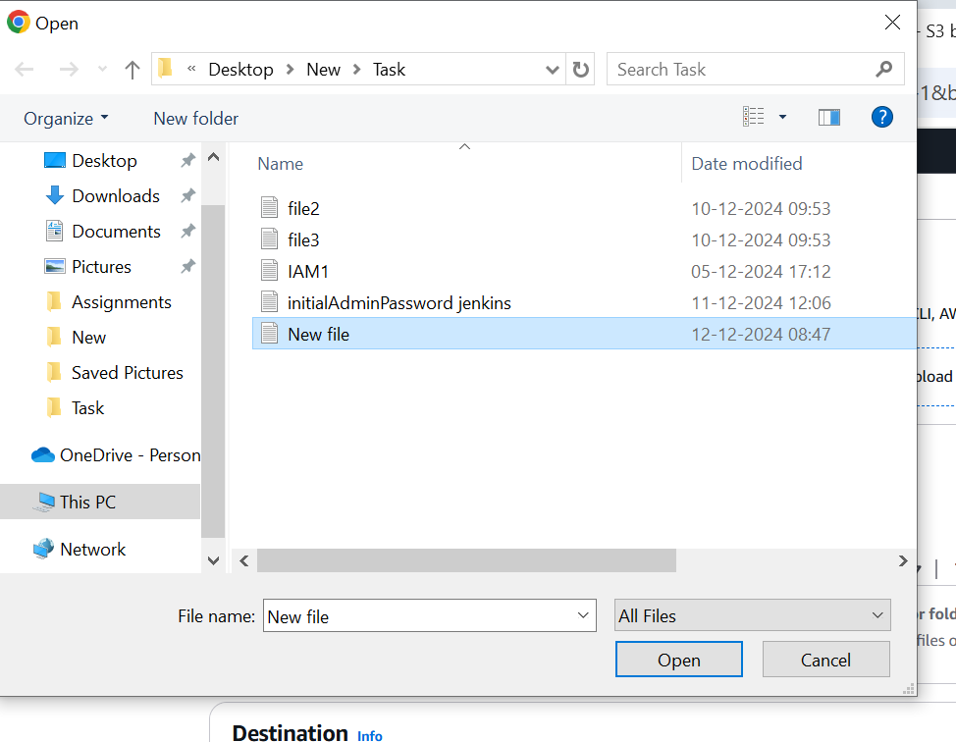
Select the file to upload.

Slide 22
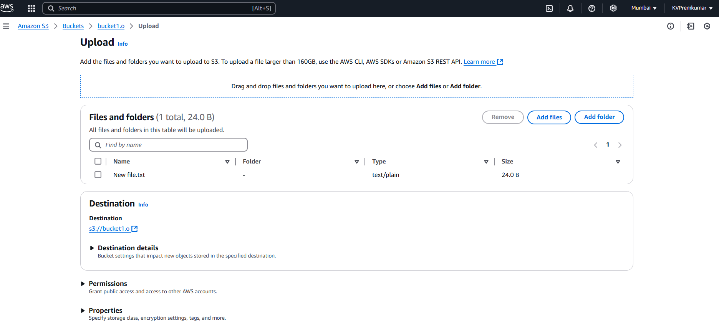
Here we see the selected file to upload.

Slide 23
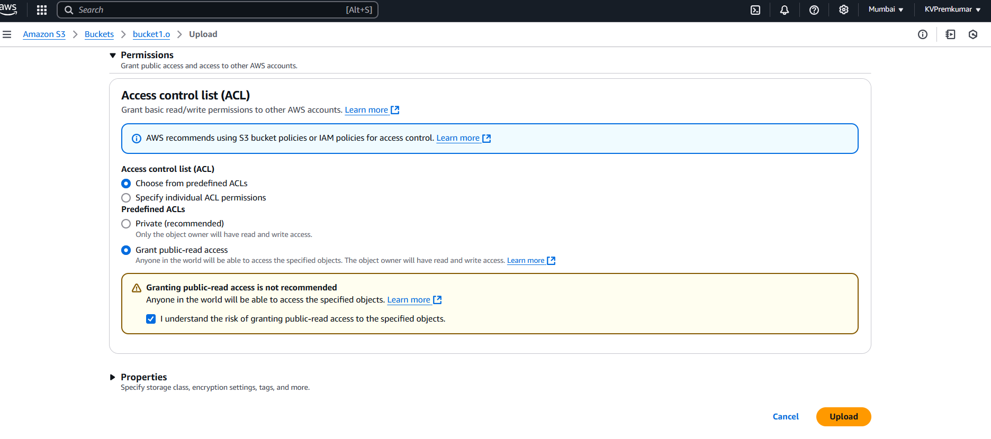
If you scroll down we will see the permissions.
We can select the Grant public-read access to make data visible in the object (optional) and after click on Upload.

Slide 24

Here we can see the file is uploaded in bucket.
After Click on the Permissions to generate the policy.

Slide 25
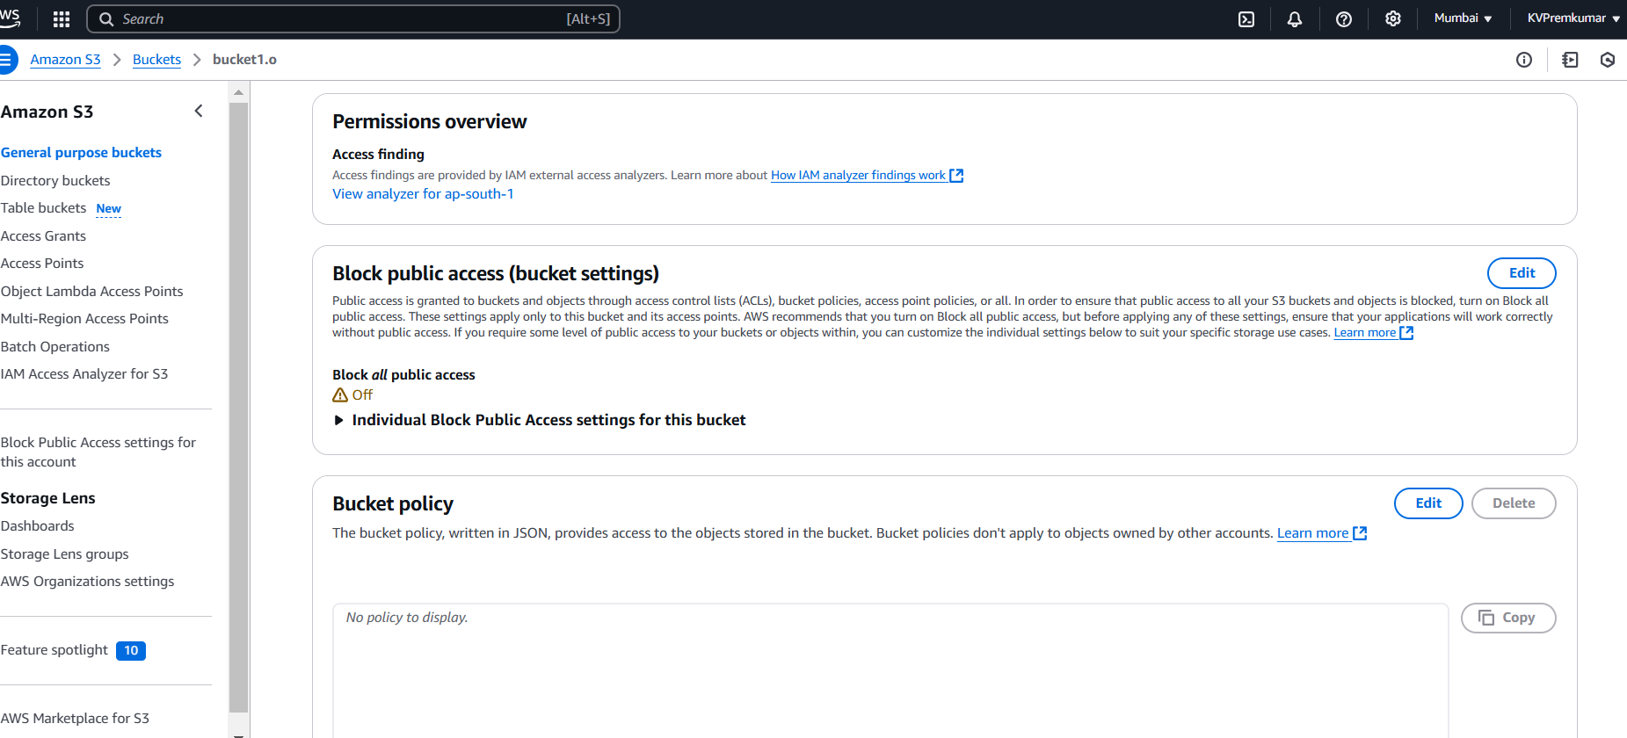
In the Permissions select the Bucket policy and click on Edit option.

Slide 26
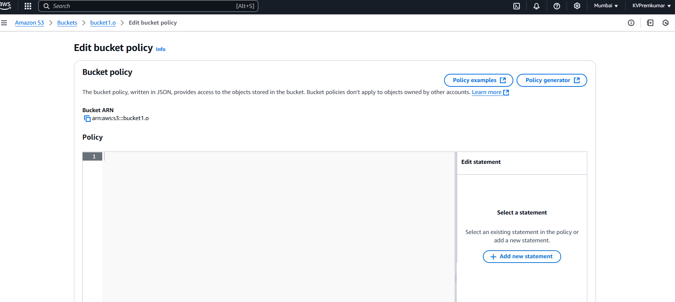
In the Edit bucket policy Click on Policy generate option.

Slide 27
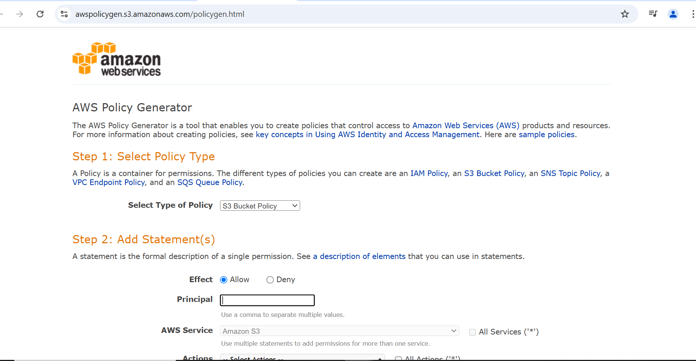
In new tab the page is open to the Generate the policy in Step by Step.
Step 1: Select the Policy Type as S3 Bucket Policy.

Slide 28
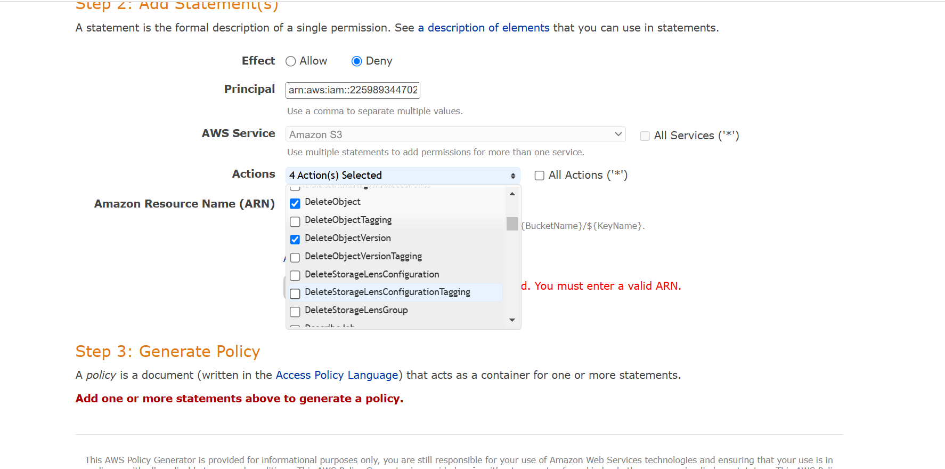
Step 2: Select the options to give permissions as per required (like Effect, Principal, AWS Service is default, Actions, ARN).

Slide 29
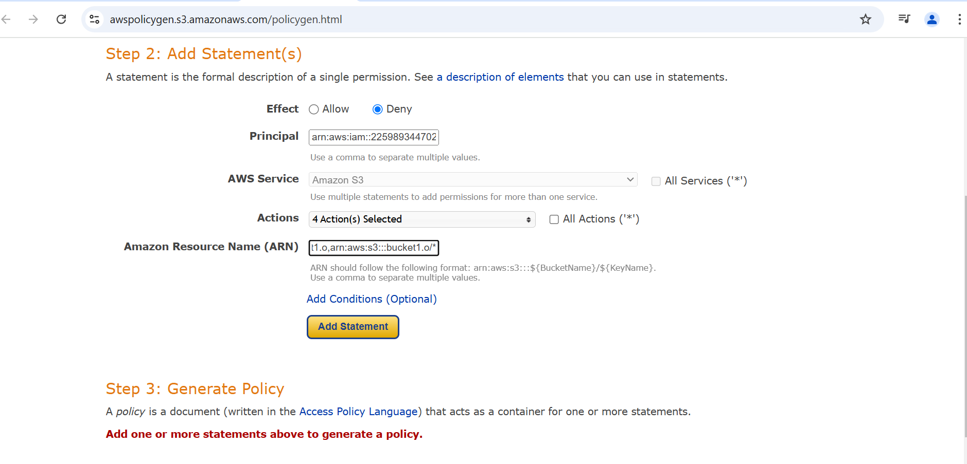
Step 3: After completion of filling the option, Click on Add Statement.

Slide 30
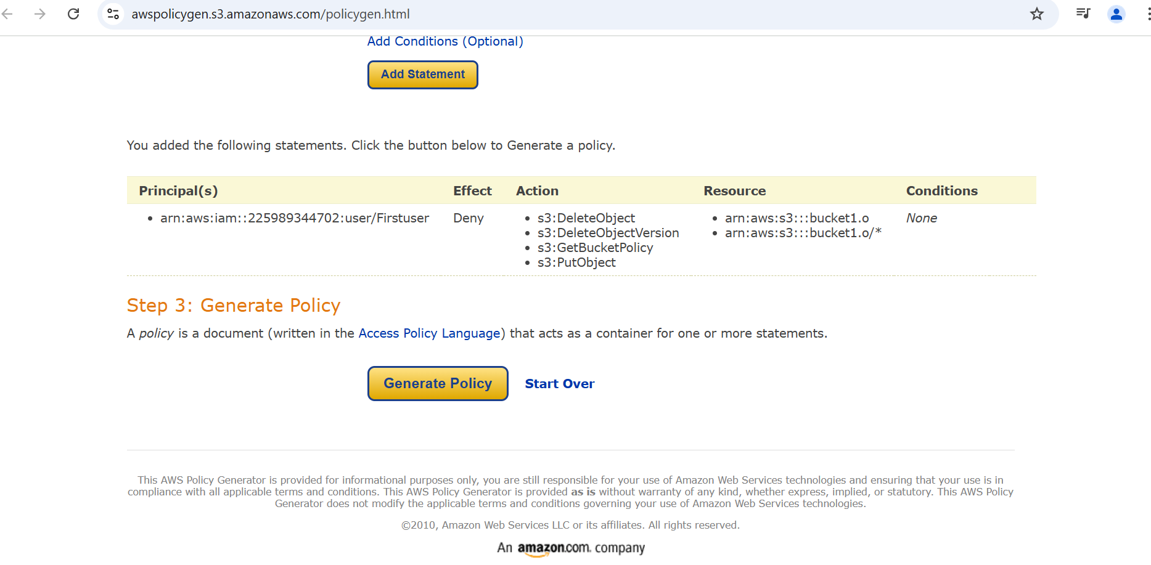
We can check the statements which we added in the below.
Step 4: After Click on Generate Policy.

Slide 31
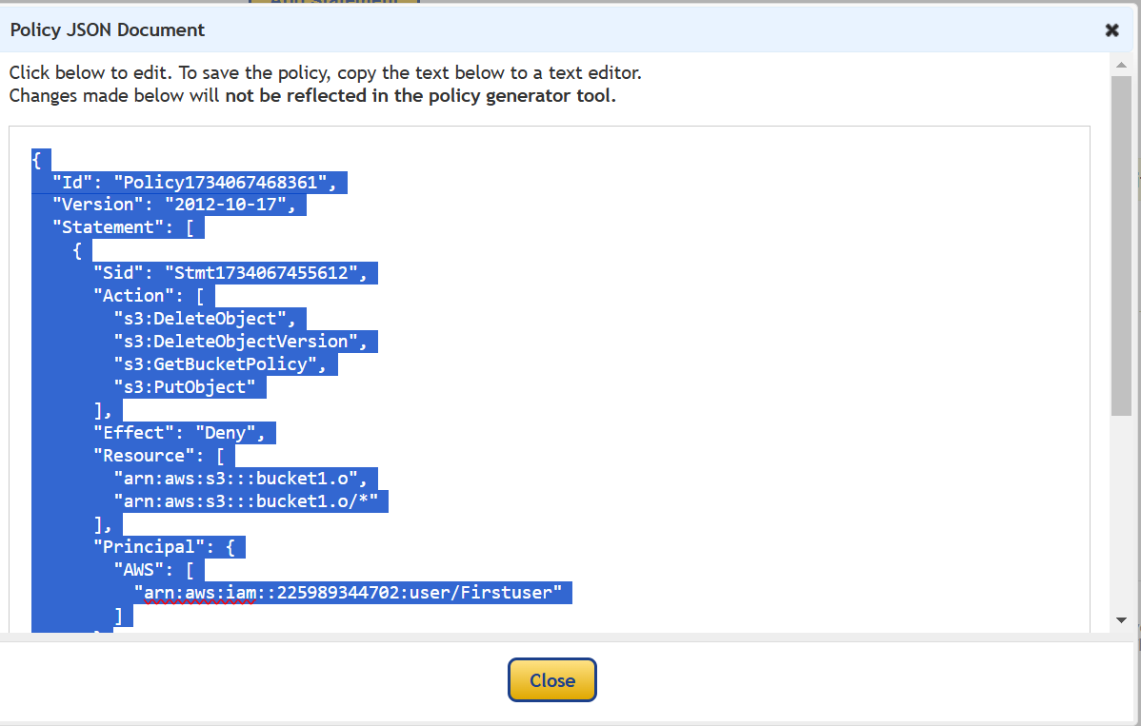
Step 5: Here the bucket policy code is generated in JSON, select the code and copy the code.
Step 6: Go Back to the Edit Policy Bucket.

Slide 32
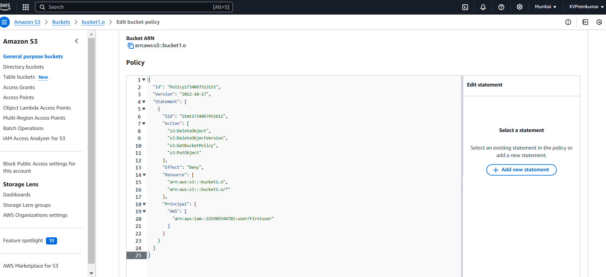
Step 6: Paste the code in the policy and click on save changes in the below.

Slide 33
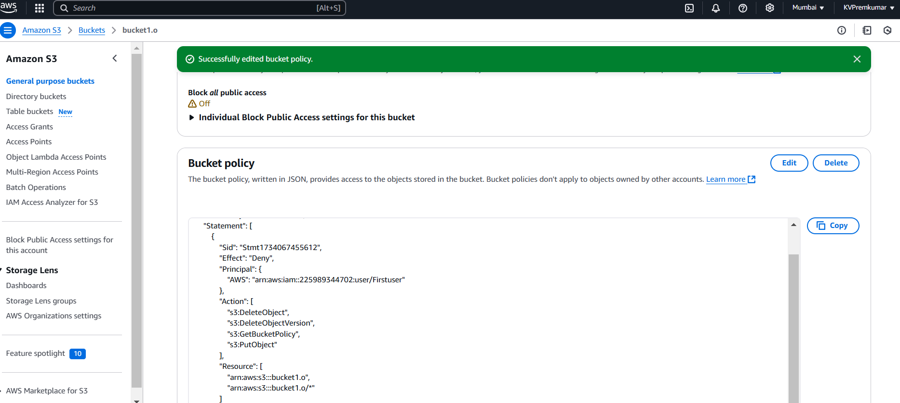
Here the bucket policy is successfully edited and we can access the bucket up to the permissions given in the policy.

Slide 34
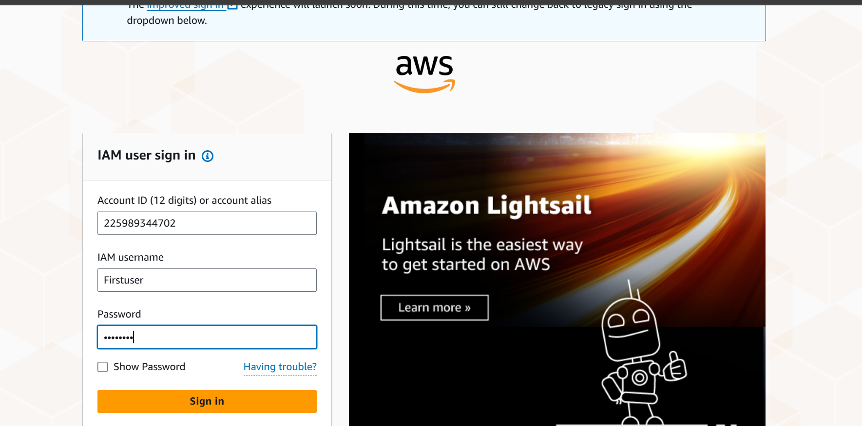
Login with the user account with copied credentials.

Slide 35
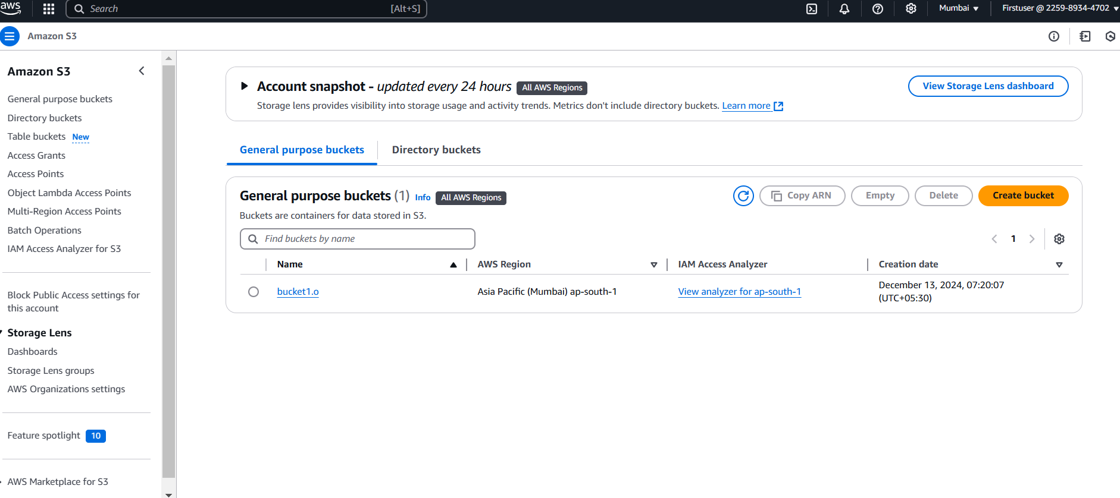
Try to access the bucket permissions which we added statements in the policy.

Slide 36
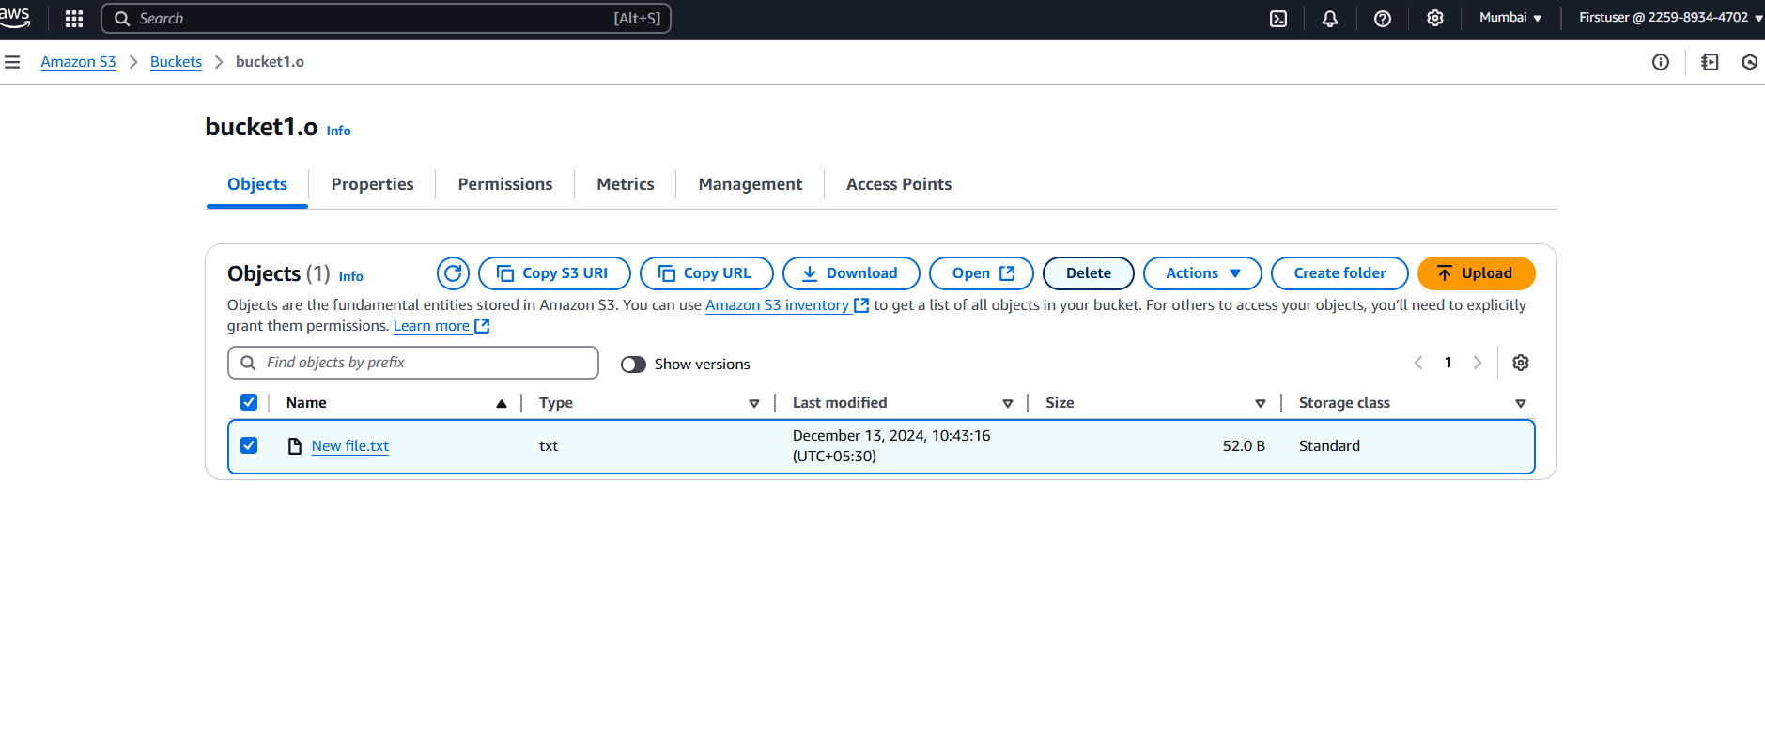
Here we are trying to Delete the Object from the Bucket.

Slide 37
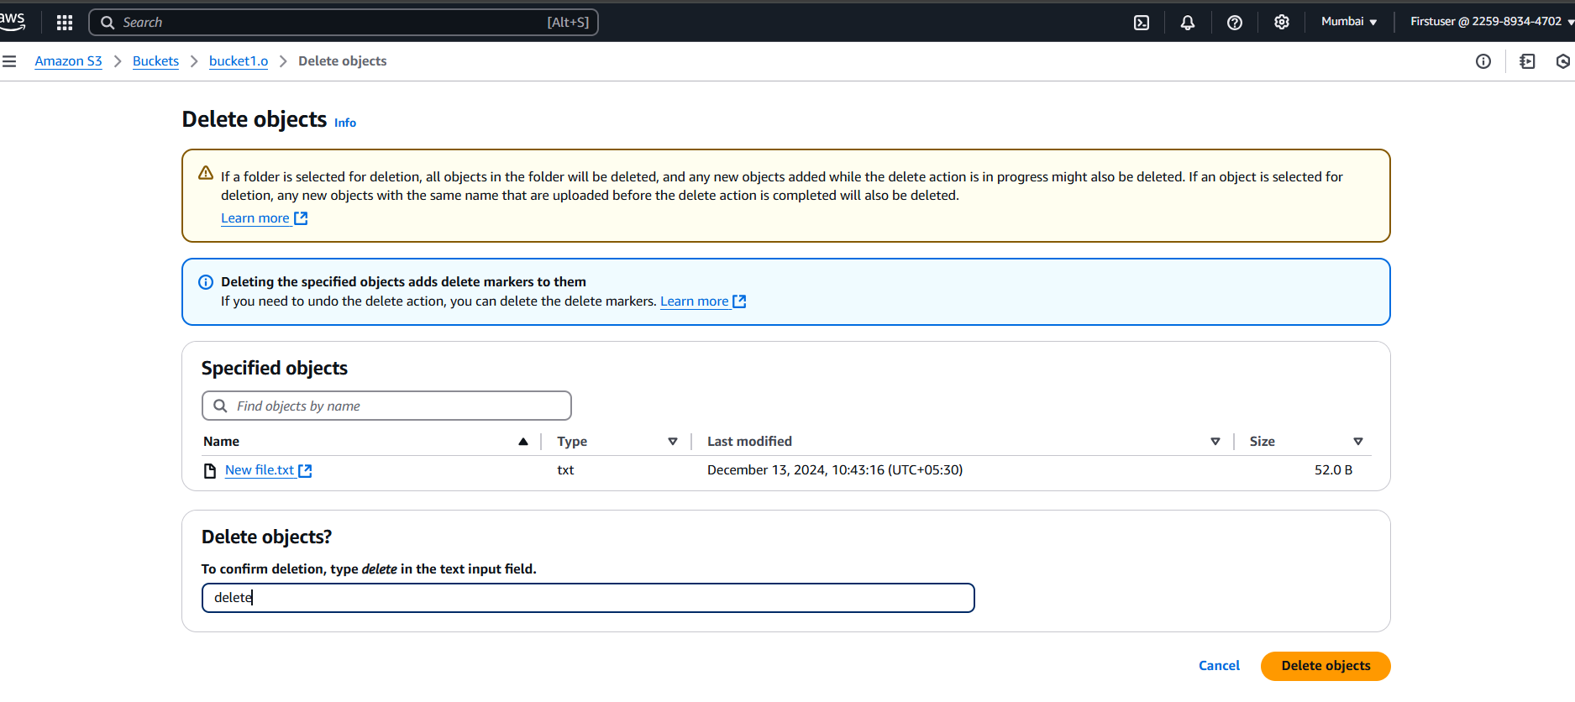
Deleting process.

Slide 38
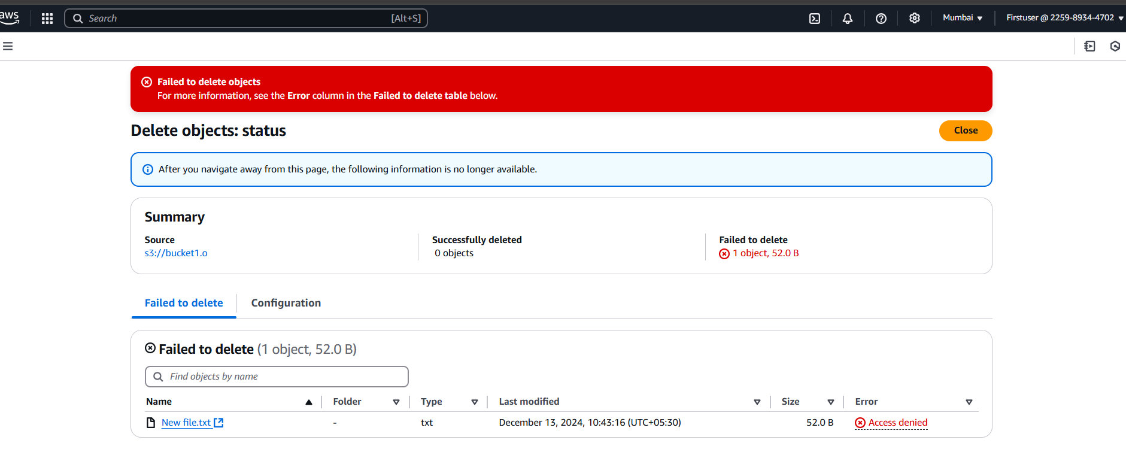
Here we can see the object is not delete because of given Deny permission to DeleteObject.

Slide 39
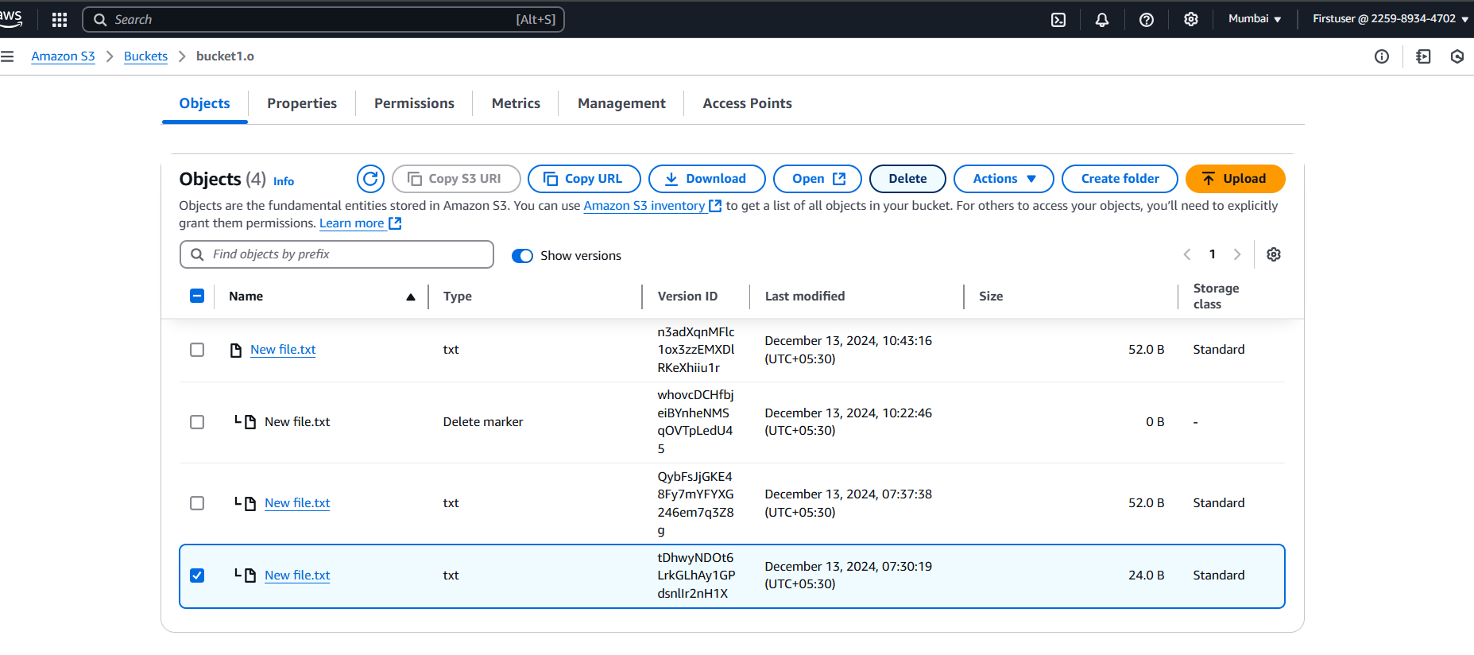
Here we are trying to Delete the old version object from the Bucket.

Slide 40

Here we can see the old version object is not delete in the because of given Deny permission to DeleteObjectVersion.

Slide 41

Here we can see the object is not upload because of given Deny permission to PutObject.

Slide 42
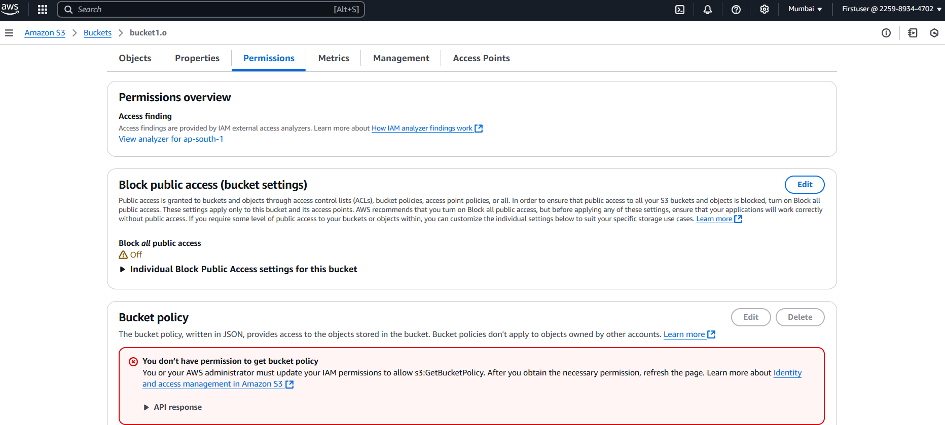
Here we can see the not allowing permission to get Bucket Policy because of given Deny permission to GetBucketPolicy.

Slide 43
Thankyou

